Slide 1

Library Management System
Steve See Kwang Long
28 March 2025

Slide 2

Agenda
What is LMS about?
Tech Stack
Key Features
Key Rules
System Architecture
High Level Design
Wireframes & Screenshots
Documentation
Challenges & Lesson Learnt
Possible Enhancements

Slide 3

What is it?
Implemented a Library Management System (LMS) :
Borrow and return books
Track books loan status and fines
Borrow history
Add new users and books
Register new members
Password reset
Performance (<= 3 secs)
Validations in place (e.g. password checks, duplicate IDs)

Slide 4
Technology Stack
Frontend: React
Backend: Spring boot
Database: MySQL
API testing: Postman

Slide 5
Key Features
User management:
Login / Logout
Add Admin
Remove Admin
Edit Admin
Add Member
Remove Member
Edit Member
Search Users
Book management:
Add Books
Remove Books
Edit Books
Search Books
Lending management:
Borrow Books
Return Books
Track Loan Status
Overdue
Fines
Miscellaneous:
Password reset
Register new members

Slide 6

Key Rules
Borrow Books:
Cannot borrow if there is overdue book
Max 3 books
Admin:
Cannot edit or remove book if it is borrowed/overdue
Cannot remove user if he has borrowed book
Fine Calculation:
$0.50 per day overdue, up to max. of $20

Slide 7
System Architecture
Frontend (React)
App.jsx
RegisterMember.jsx
ResetPassword.jsx
BorrowingHistory.jsx
etc
Backend (Java Spring Boot)
Controller (Users, Books, Borrowings)
Data Transfer Object (LoginRequest)
Service (Users Svc, Books Svc, Borrowings Svc)
Model (User, Book, Borrowing)
Repository (UserRepo, BookRepo, BorrowingRepo)
DB (MySQL)

Slide 8
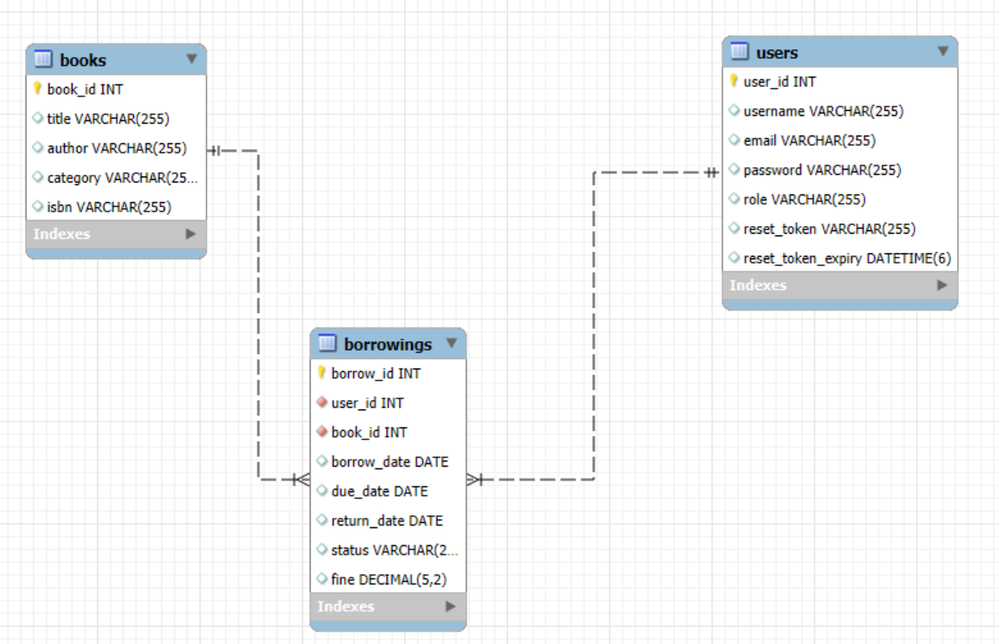
Database Schema

Slide 9
Wireframes
System Name
Username
Password
Login
Forgot Password?
Register New Member

Slide 10
Wireframes
Add New Book
Book ID
Title
Author
Category
ISBN
Add Book
Inventory of Books
ID | Title | Author | Category | ISBN | Due Date | Status | Fine | Action
 |  |  |  |  |  |  |  | <Borrow, Return, Edit, Remove>
Page 1 of 10

Slide 11
Wireframes
Add New User
User ID
Username
Email
Enter Password
Select Role
Add User
List of Users
ID | Username | Email | Role | Action
 |  |  |  | <Edit, Remove>
Page 1 of 10

Slide 12
Wireframes
Borrowing History
Borrow ID | Title | ISBN | Borrow Date | Due Date | Return Date | Status
 |  |  |  |  |  | <Returned, Borrowed>
Page 1 of 10

Slide 13
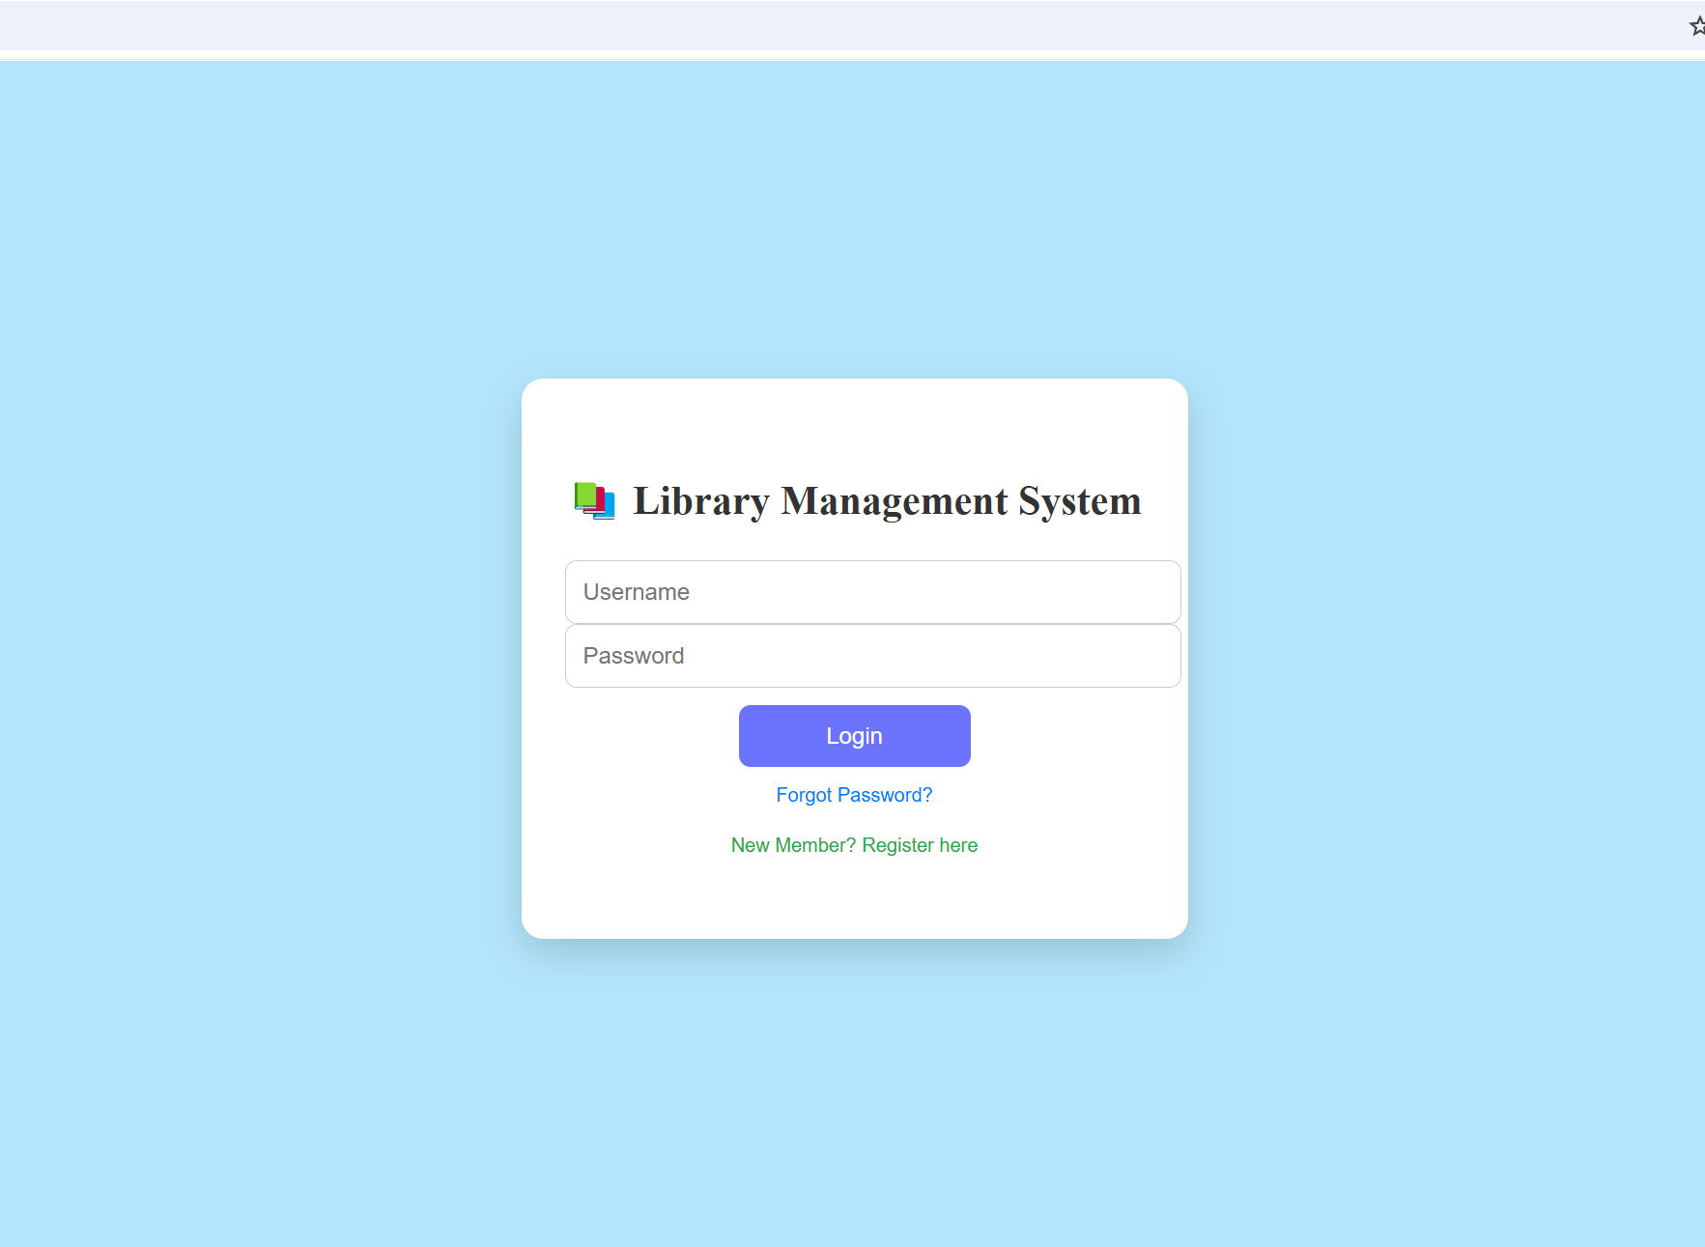
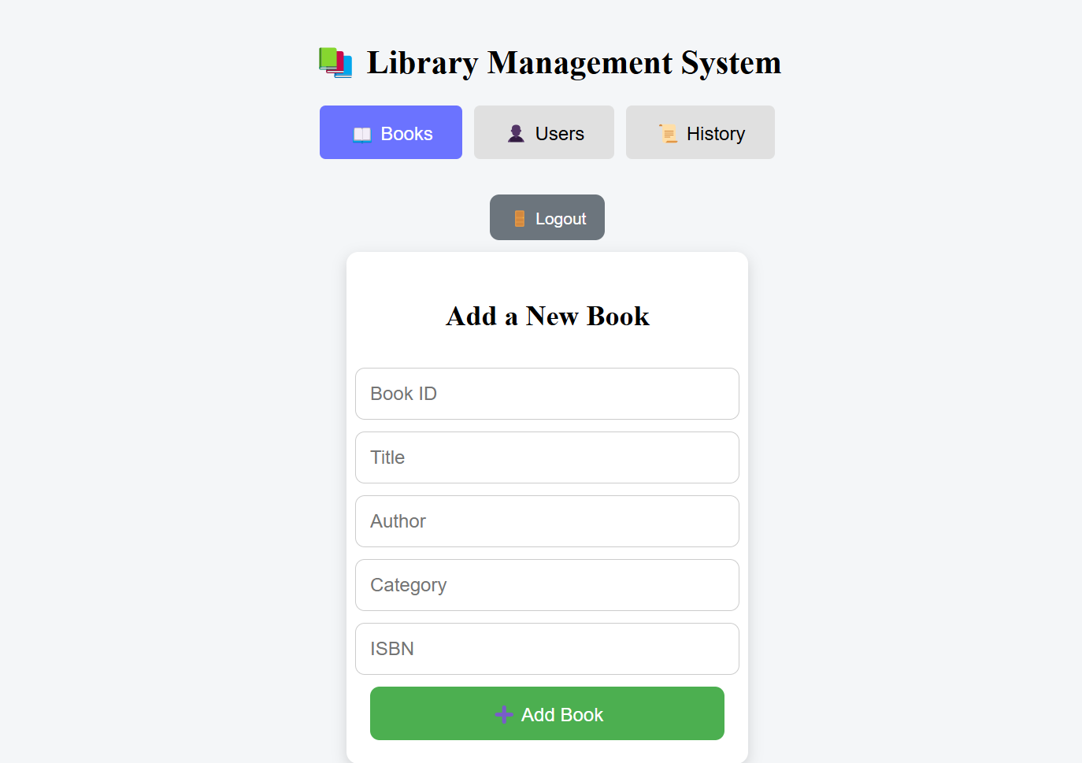
Screenshots

Slide 14
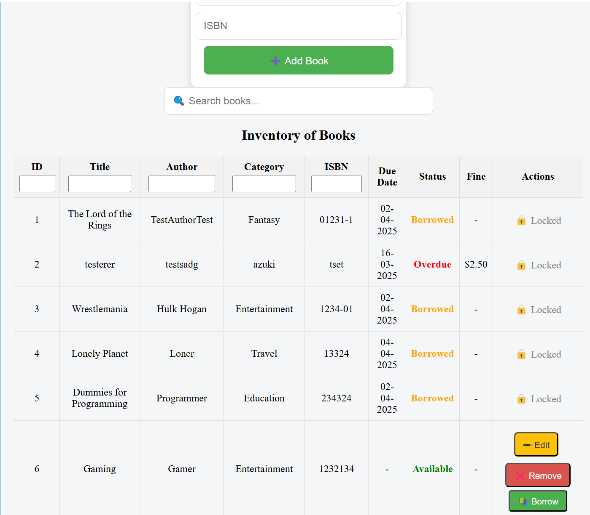
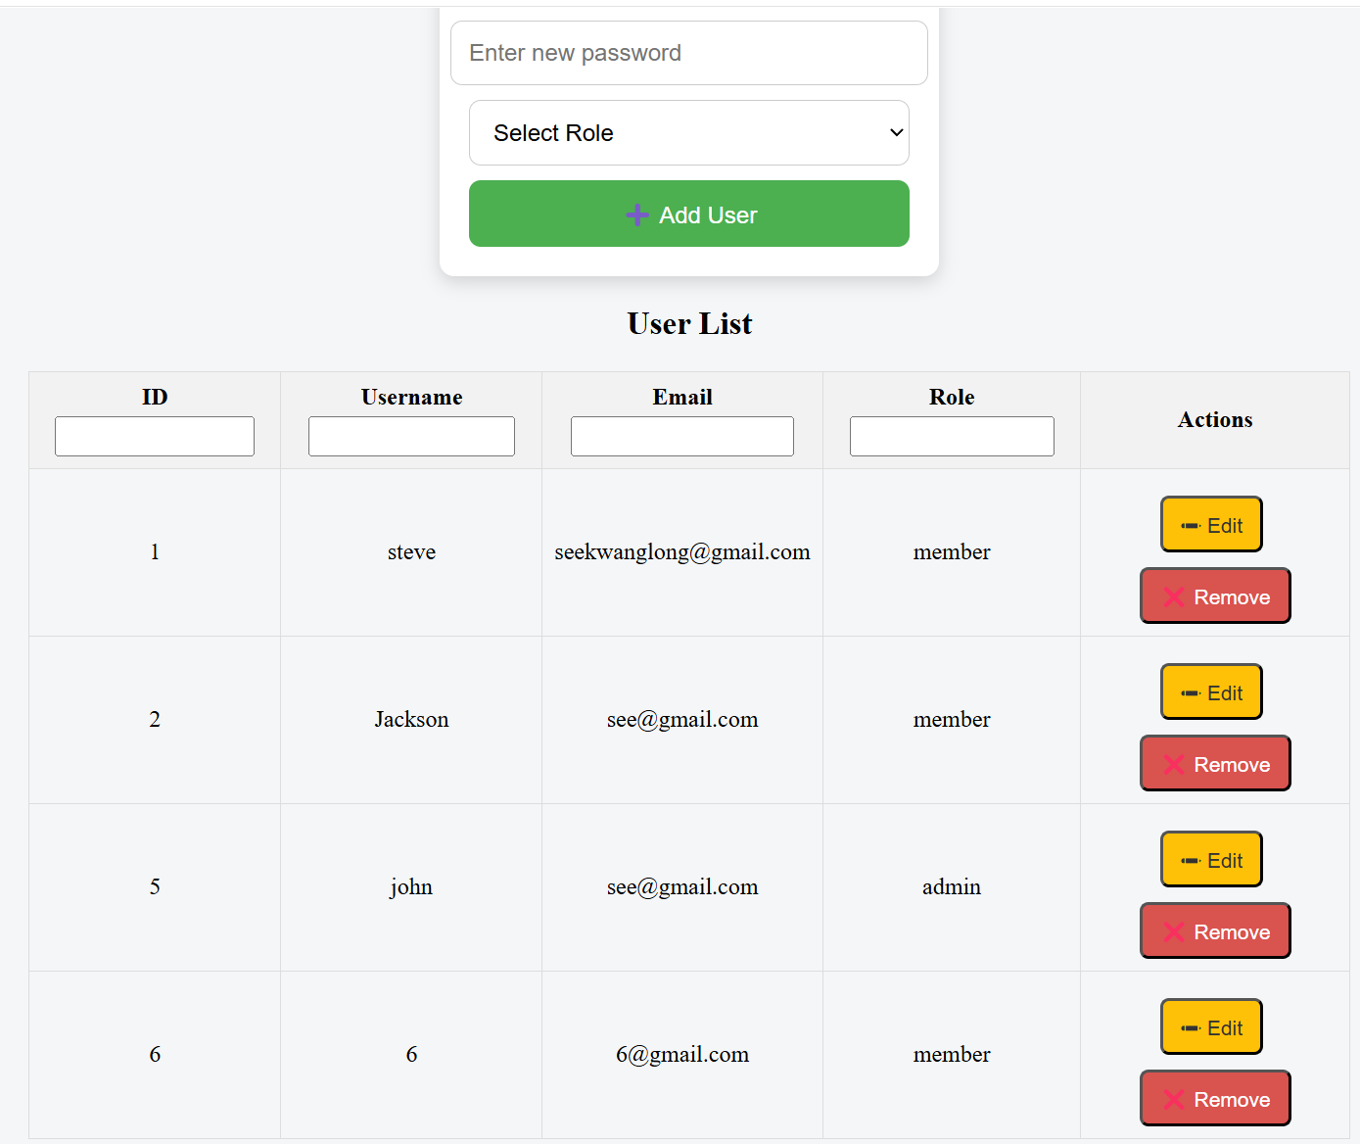
Screenshots

Slide 15
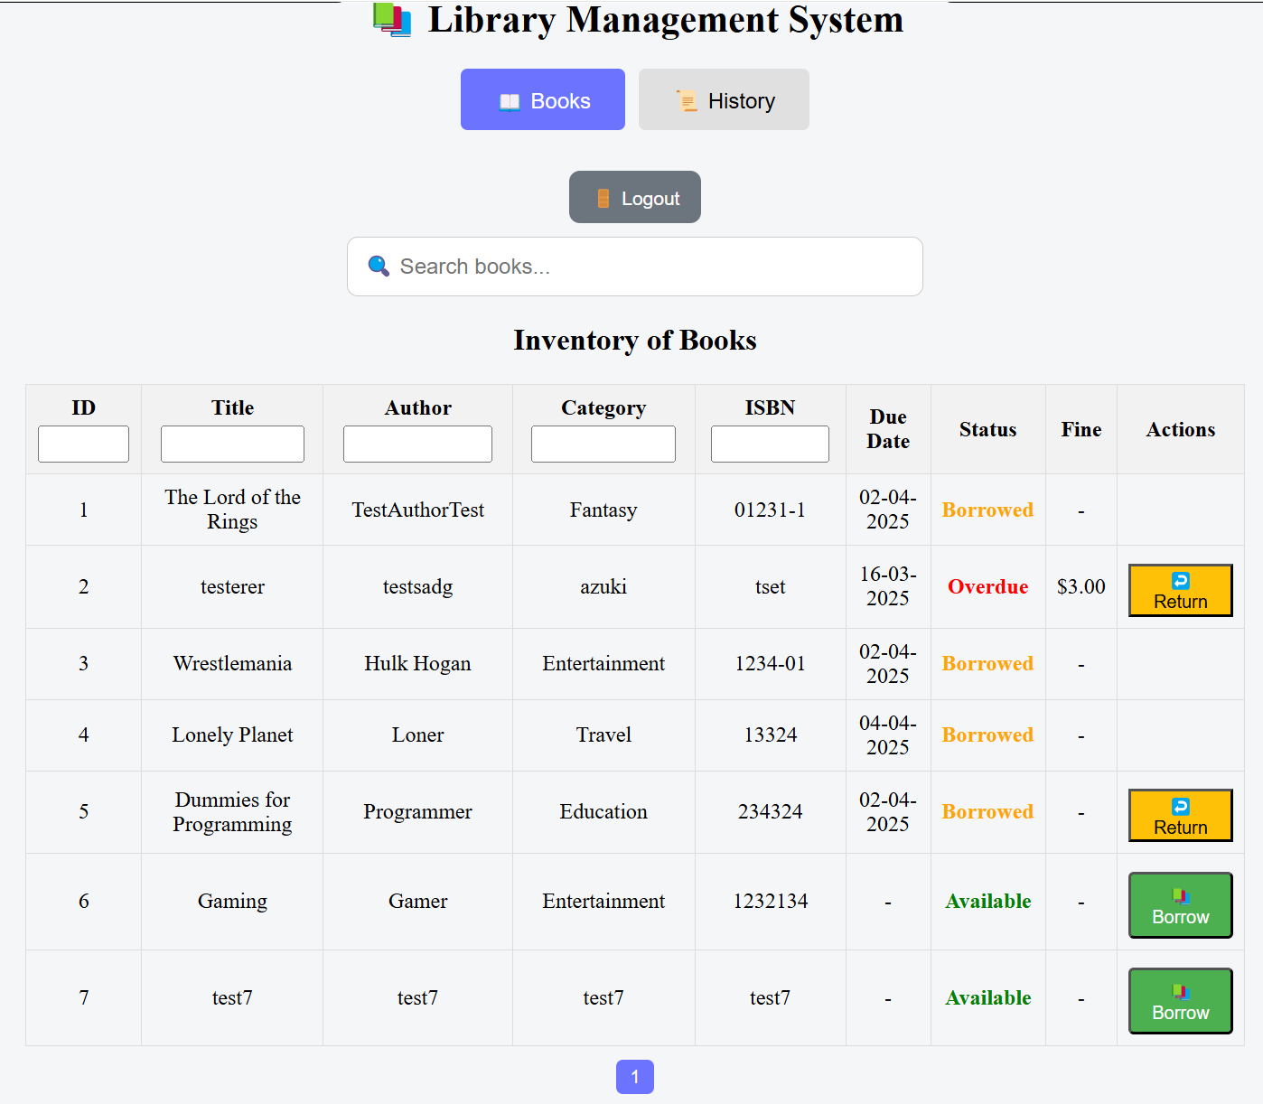
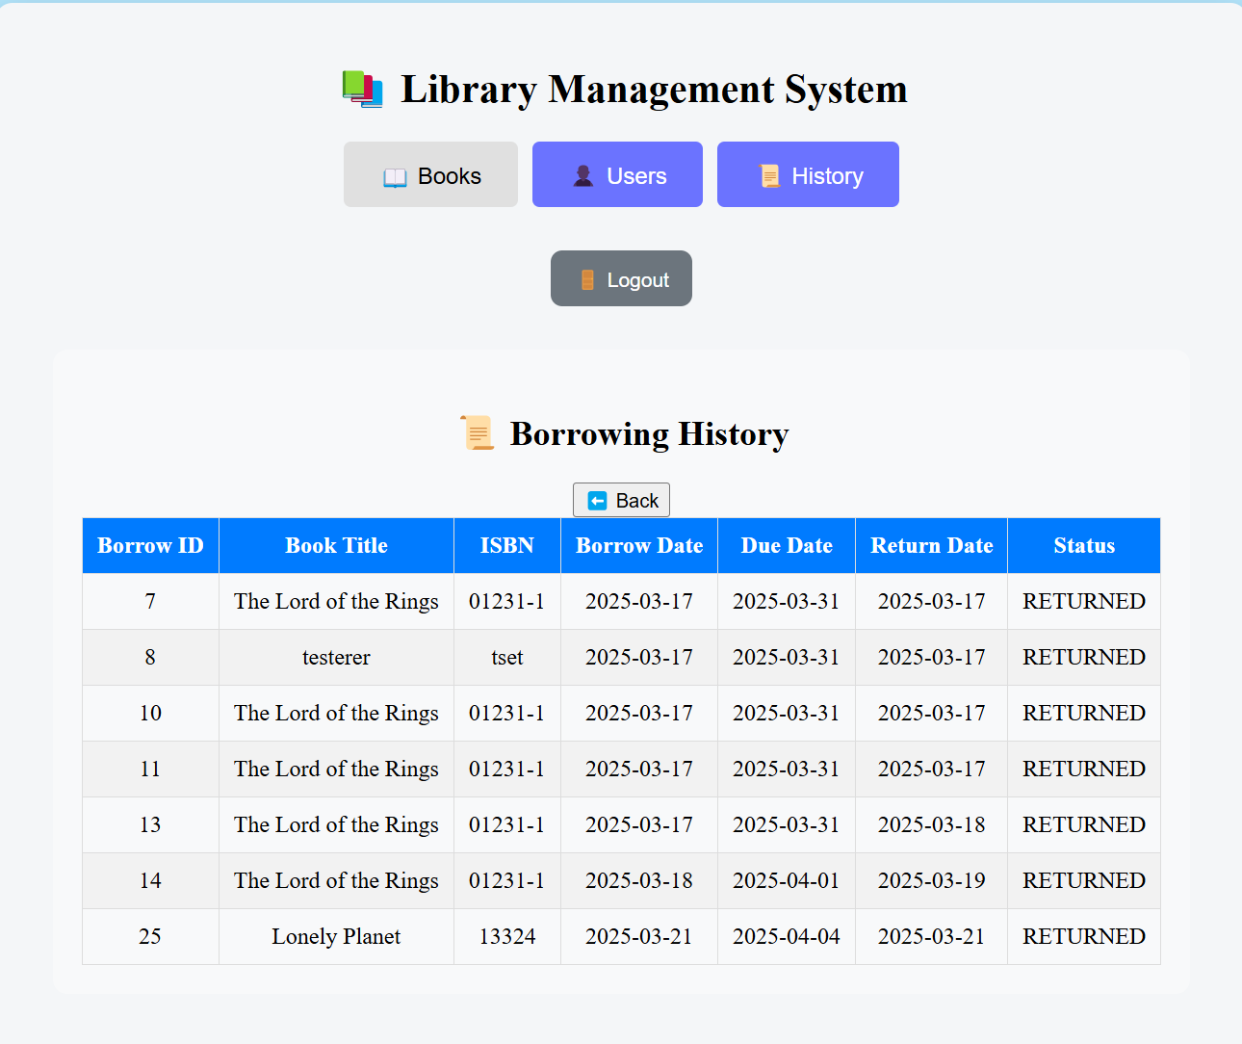
Screenshots

Slide 16
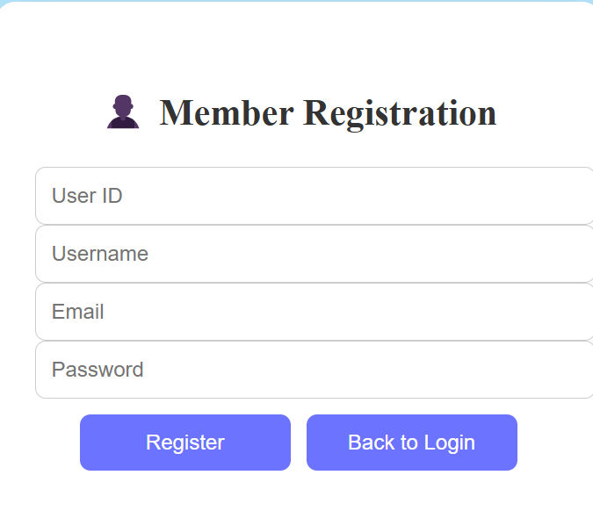
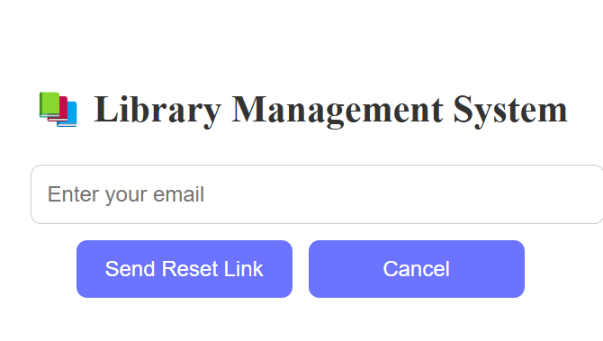
Screenshots

Slide 17
Documentation
BRD, SRS
ERD
Test Cases (36 test cases)
User Manual

Slide 18
Challenges & Lesson Learnt
Leverage ChatGPT wisely
Divide and conquer
Know the common failure points
API request / response (use Chrome Inspect, Postman)
Frontend (e.g. userState issues)
Backend (e.g. API parameters not matched)

Slide 19
Possible Enhancements
Reserve Books
Facility to repay fines
Membership validity dates
Enhance UI/UX further
Security testing

